Slide 1
Analysis of Methods to deal with Censored Data in the Integrated Report

Slide 2
Objective of the Method
Reduce bias in either direction
Find a method that fits all parameters and methodologies
Must work for cases where the detection limit or reporting limit are above the water quality standard
Transparency on method used

Slide 3
What Other States Do
State | Use of censored data
CO | Replace ND with zero. In cases of drastically different MDL or ML values possible unintentionally biased toward zero. May be appropriate to omit the dataset with a higher MDL or ML from the assessment of the data.
NM | Results from samples that are flagged by the laboratory as “below the minimum quantification or reporting limit” (generally referred to as minimum reporting limit or MRL) may only be used during the assessment process if the MRL is less than the applicable water quality criterion (WQC) or numeric threshold being assessed
FL | The Department shall treat any result less than the MDL of the method required in the permit or the method as required under subsection (10) below or any lower MDL reported by the permittee’s laboratory as being one half the MDL (if the criterion equals or exceeds the MDL) or one half the criterion (if the criterion is less than the MDL), for any pollutant. Without the permission of the applicant, the Department shall not use any values determined under this subsection or subsection (9) below for results obtained under a MDL superseded later by a lower MDL.
TX | For criteria that are expressed as averages, including chronic toxicants (aquatic life use), bacterial indicators geometric mean (recreation use), human health criteria for water (fish consumption use), and primary organic substances (public water supply use), which ever of the following measurements is smaller is used in calculating the average—half of the LOQ or half of the criterion. For values expressed as greater than the LOQ, the whole value is used.
 | When most of the reported values for a parameter are less than the LOQ, and the LOQ is significantly greater than the criterion (note that a margin of safety of about two for aquatic life and five to ten is incorporated into criteria), the samples are not used for calculation of averages or percent exceedances. A status of Not Assessed may be identified, rather than fully supporting or no concern. The assessor will use judgment when identifying parameters as fully supporting or delisting when the dataset includes nondetects.
CA | When available data are less than or equal to the quantitation limit and the quantitation limit is less than or equal to the water quality standard, the value will be considered as meeting the water quality standard, objective, criterion, or evaluation guideline.
 | When the sample value is less than the quantitation limit and the quantitation limit is greater than the water quality standard, objective, criterion, or evaluation guideline, the result shall not be used in the analysis.
 | The quantitation limit includes the minimum level, practical quantitation level, or reporting limit.
WA | Non-detect sample values will be considered in the assessment, but can only be used to show compliance with water quality criteria when the detection limit is less than the criteria. For calculating a geometric mean using non-detect samples, in which a zero cannot be used, a value will be chosen so as not to bias the geometric mean high or low.
MT | Nutrients - Convert non-detects in the dataset to 50% of reported detection limit; if >> 15% of dataset is non-detect, consult WQPB Standards Section.
 | Metals - Include non-detects in the dataset if the water quality standard (WQS) is higher than the laboratory detection limit for that metal parameter.
UT | For sample results below detection, the reported result value or a value of 0.5 times the lowest reported detection limit is applied for purposes of the assessment. However, if one-half of the detection limit is above the water quality standard, the data will not be used in the assessment.
ID | In general, imputation of censored values should be avoided in small (500). If censored measurements comprise less than 50% of the measurements of an analyte and the data set appears to be parametrically distributed (either normal, lognormal, or gamma), then the statistical parameters of the distribution are best inferred using distributional methods such as the maximum likelihood estimator (e.g., Helsel 1990; 2005; the utilities available in ProUCL 5.0 [EPA 2013a]) are recommended for such situations. If censored measurements comprise more than 50% of the data set, nonparametric analysis is generally preferred unless special circumstances apply (EPA 2009); in that case multiple methods for estimating the distribution’s parameters should be evaluated, including a sensitivity analysis of the results, before deciding on the best outcome. In special cases, such as where the nondetect percentage is very high, DEQ may approve alternative methods for handling censored data on a case-by-case basis.
Set to Zero
Eliminate
½ MDL
½ Criteria
Use the lowest Value - ½ of the MDL or ½ of the Criteria

Slide 4
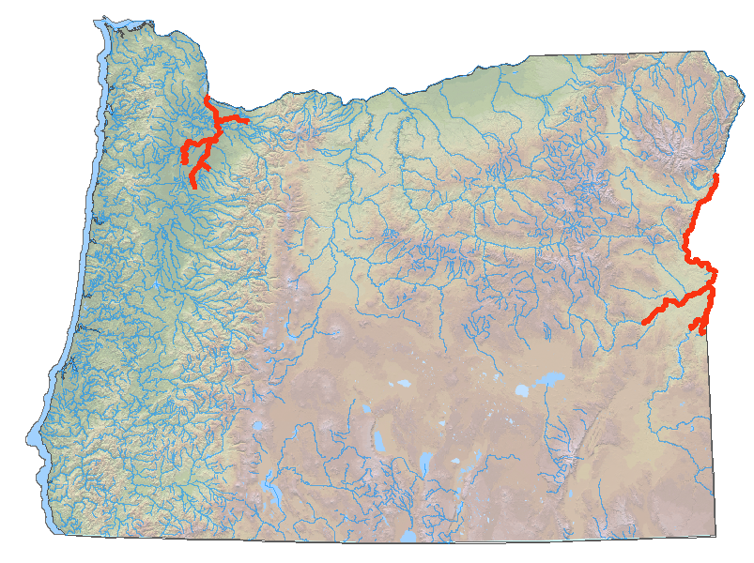
Test Case – 4,4 DDT
Water Quality Standards
Human Health - 0.000022 µg/L
Aquatic Life Chronic - 0.001 µg/L
Aquatic Life Acute - 1.1 µg/L
Average Reporting Level = 0.0283 µg/L
(based on 3645 samples analyzed at the DEQ lab)
Segments Currently on the 303(d) list for 4,4 DDT

Slide 5
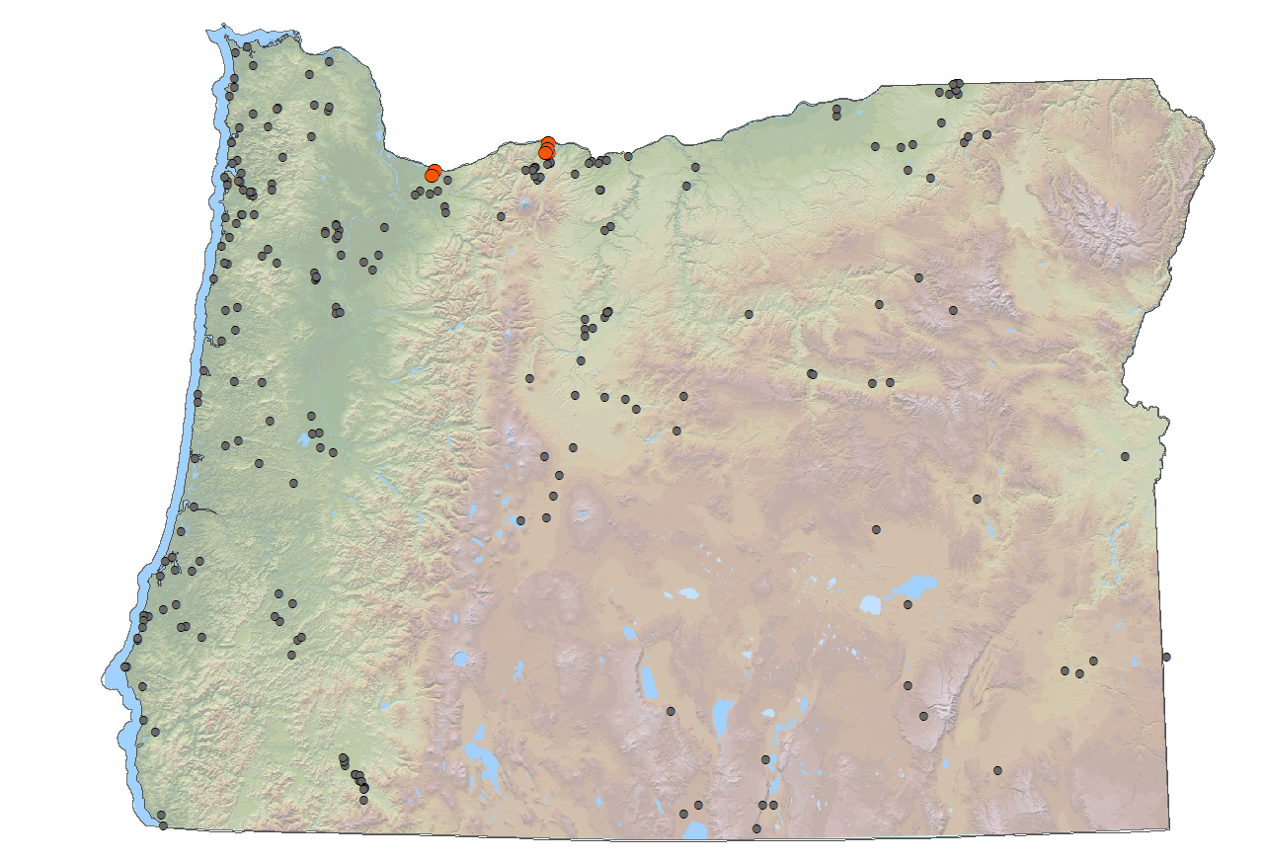

Analysis of Methods -Human Health Criteria
Sites Resulting in Listings for 4,4 DDT by Method
method | number of sites | percent samples exceeding | number of sites listed | percent sites listed
Use Reporting Limit | 245 | 100 | 245 | 100
Use 1/2 Reporting Limit | 245 | 100 | 245 | 100
Set to 0 | 245 | 0.49 | 4 | 1.63
Eliminate | 6 | 100 | 6 | 100
Use 1/2 Criteria | 245 | 0.49 | 4 | 1.63

Slide 6
Recommendation
Use generic term – Reporting Limit – includes: MDL, MRL …. quantifiable
Use for all assessment methodologies
Results reported above the reporting limit – Use value
Result reported below reporting limit (<, ND) – Use ½ WQS criteria
Results reported between the MRL and MDL (estimates) – Use value – If the sample(s) exceed criteria, assign Category 3B if and only if there are no other quantifiable sample(s) in the AU that exceed the criterion. Otherwise, the waterbody shall be assigned to Category 5, following the exact binomial test procedures.

